Slide 1


Personalized Medicine: Redefining Cancer Treatment
李宁山
2017/12/27
Neural Information Processing Systems

Slide 2
NIPS 2017 Competition
Classifying Clinically Actionable Genetic Mutations
Memorial Sloan Kettering Cancer Center (MSKCC)
Data from an expert-annotated precision oncology knowledge base
Determining oncogenicity (4 classes) and mutation effect (9 classes) of the genes based on abstracts of medical articles
https://www.kaggle.com/c/msk-redefining-cancer-treatment/data
1st place - $ 10,000
2nd place - $ 3,000
3rd place - $ 2,000
2017 26 Jun – 1 Oct

Slide 3
A Glance of Data
ID | Gene | Variation | Text | Class
1627 | VHL | Deletion | … | 1
…… Molecular genetics Following the mapping of a gene for VHL disease to the short arm of chromosome 3, large scale gene mapping studies and the identification of large germline deletions (100 kb) led to the identification of VHL ……
Some train sample has no text
Some gene can not be found in text
ID | Gene | Variation | Text | Class
0 | ACSL4 | R570S | … | ?
This mutation resulted in a myeloproliferative phenotype, including erythrocytosis, in a murine model of retroviral bone marrow transplantation ……

Slide 4
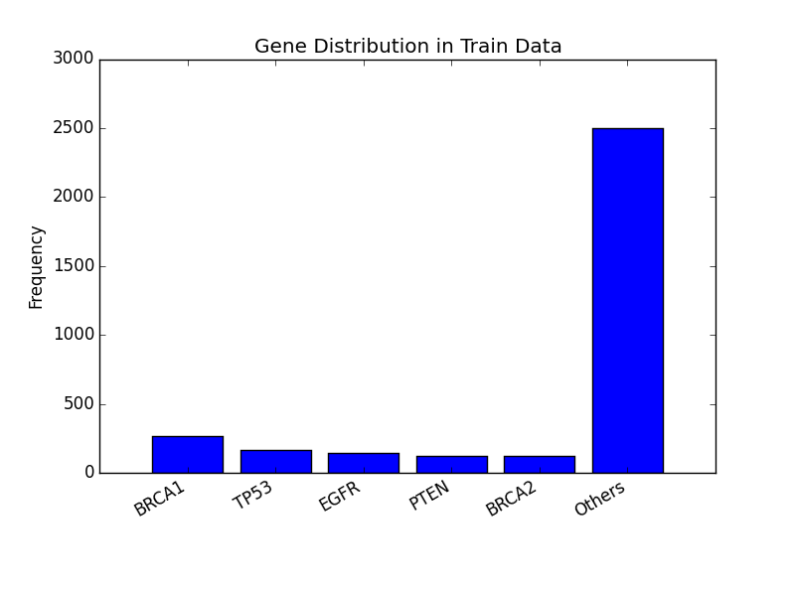
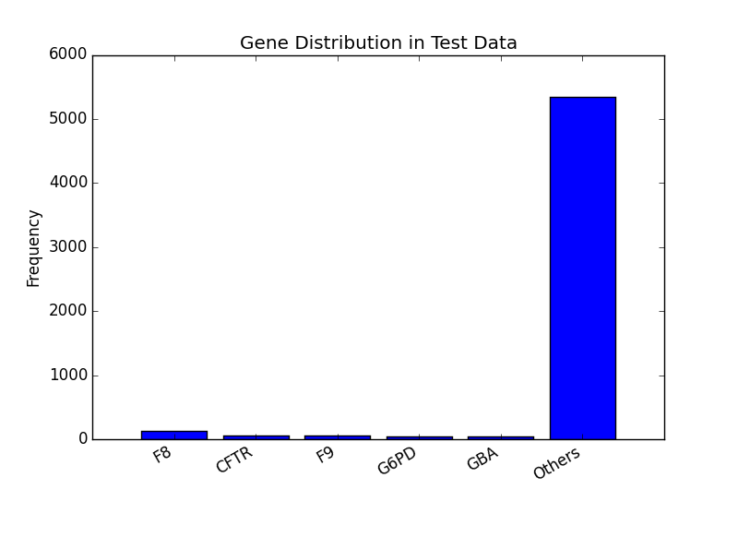
Gene Distribution
Train Data Set N=3,321
Test Data Set N=5,668
Unique Gene N=264
Unique Gene N=1,397

Slide 5
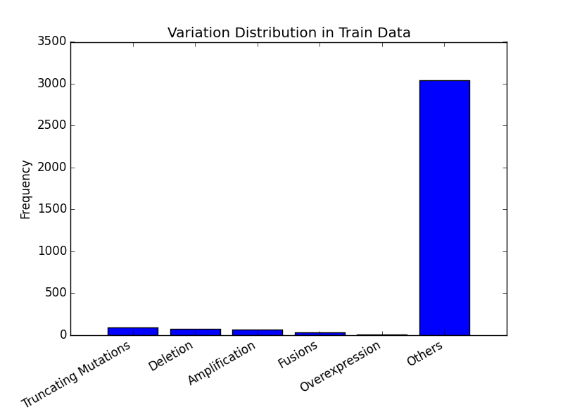
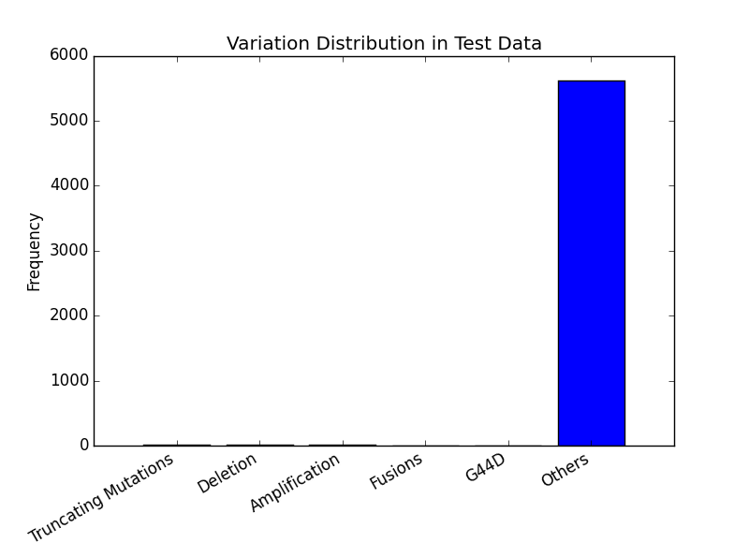
Variation Distribution
Train Data Set N=3,321
Test Data Set N=5,668
Unique Variation N=2,996
Unique Variation N=5,628

Slide 6
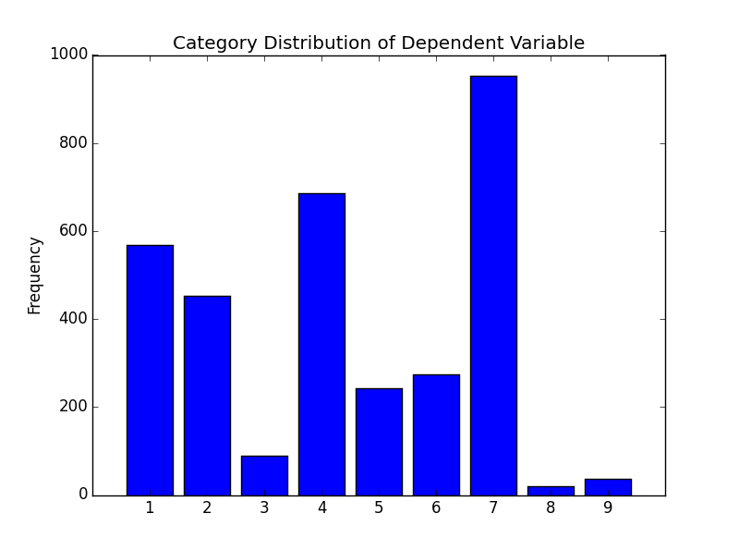
Dependent Variable
Train Data Set N=3,321
Unique Articles N=1,315

Slide 7
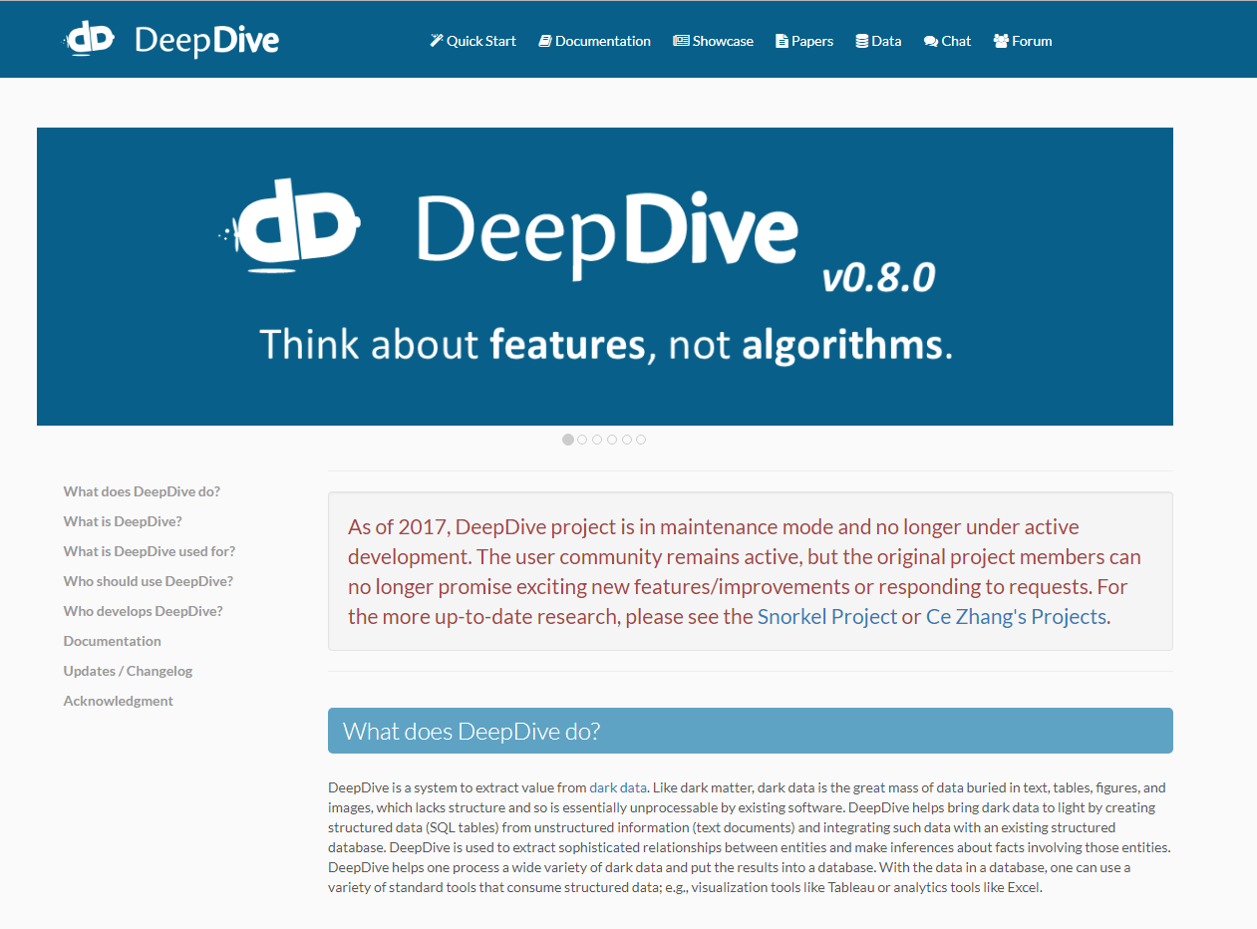
DeepDive: An Information Extraction Tool
http://deepdive.stanford.edu/

Slide 8
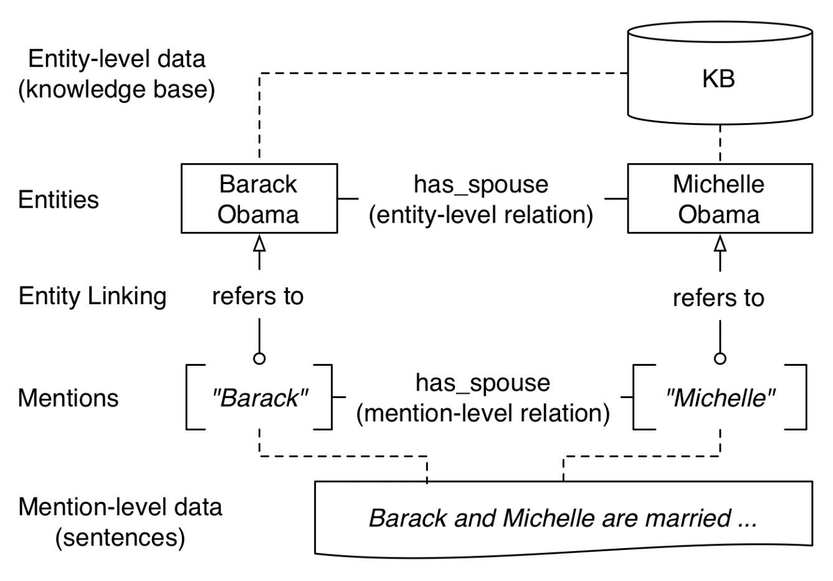
DeepDive: Knowledge Base Model

Slide 9
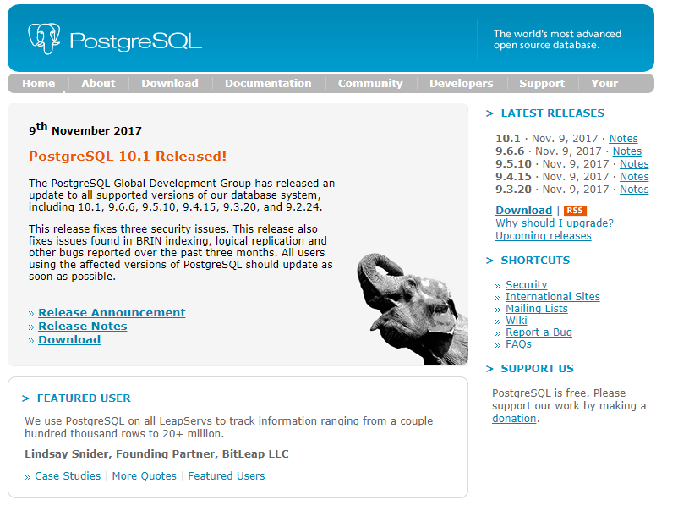
Data Storage
All raw, intermediate data and result are stored in PostgreSQL database through TCP/IP connection
https://www.postgresql.org/

Slide 10
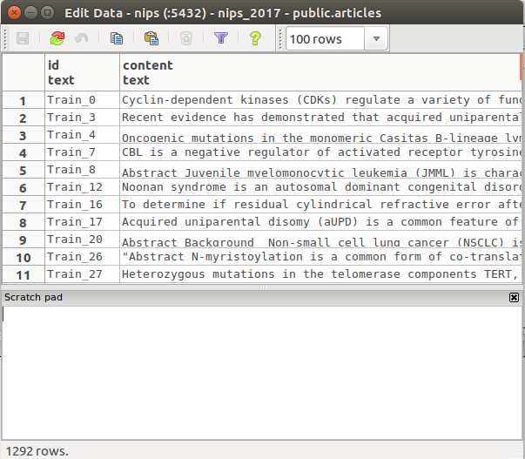
Step 1 Load Raw Articles
Total 1292 articles, excluding 23 articles which can raise error during copying into database

Slide 11
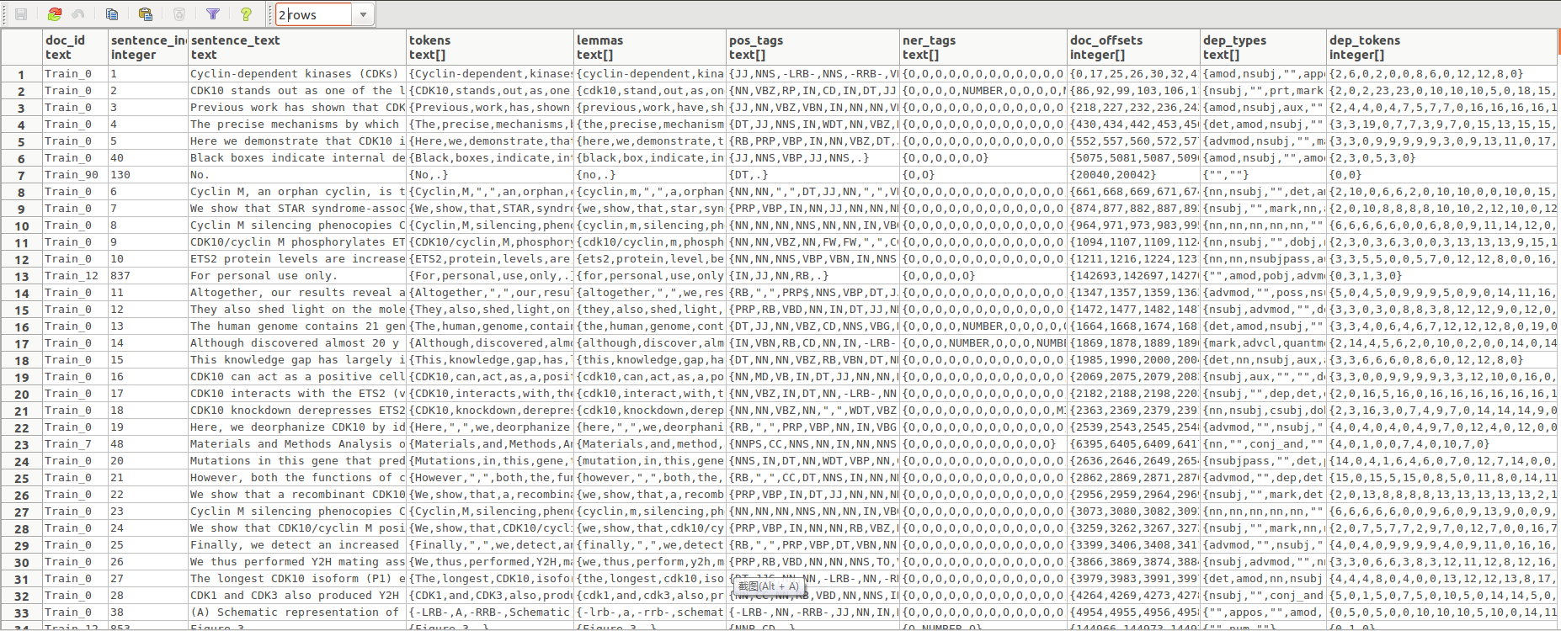
Step 2 Natural Language Processing
Total 577,609 sentences, using standford’s coreNLP system

Slide 12
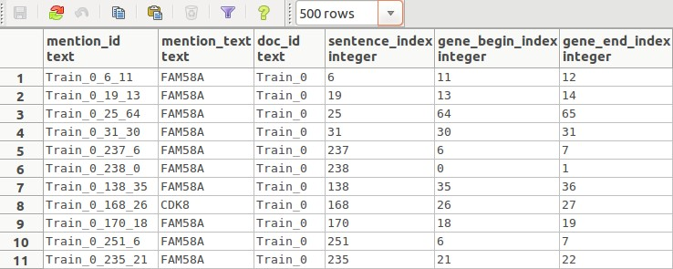
Step 3 Gene Identification
Gene Identification Rule:
Rule 1: in gene list
Rule 2: identified by coreNLP as a gene name
Total 211,992 gene mentions

Slide 13
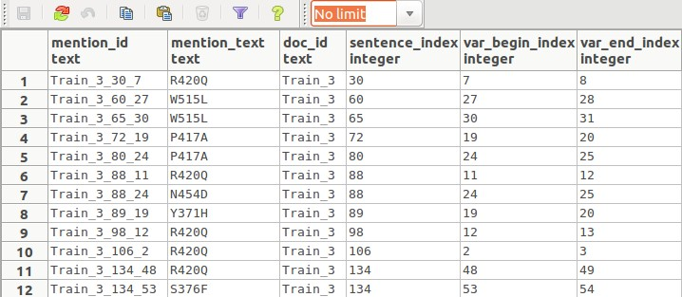
Step 4 Variation Identification
Variation Identification Rule:
Rule 1: in variation list
Total 56,149 gene mentions

Slide 14
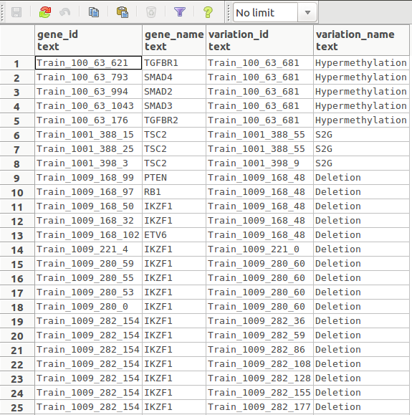
Step 5 Gene Variation Matching
Matching Rule:
Rule 1: in the same document, and the same sentence
Total 68,196 gene-variation pairs

Slide 15
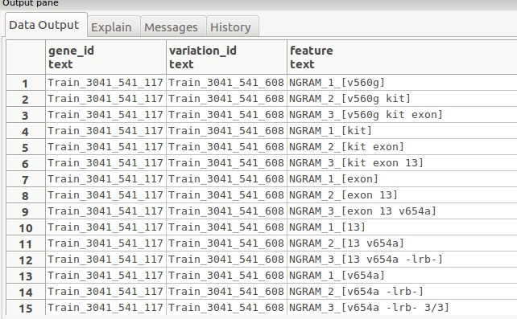
Step 6 Generating Features
Using DDLib to generate features
Total 20,472,200 gene-variation feature records
Each gene-variation pair on average has 300 features

Slide 16
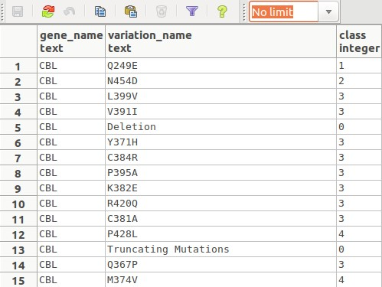
Step 7 Load Train Labels
N=3,321
Train: 2,491
Valid: 830
Notes:
3,321组gene-variation pair中没有重复

Slide 17
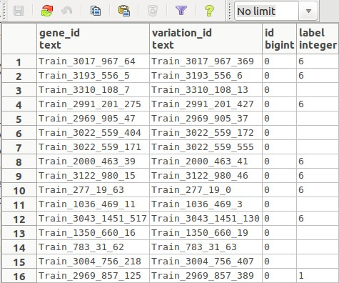
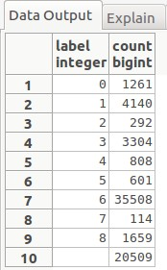
Step 8 Construct Training Samples
Total 68,196 gene-variation mentioned pairs
30.07% unknown class

Slide 18
Step 9 Learning through Distant Supervision
Gene
Variation
Effect=?
Feature 1
Feature 2
Feature 3
W2
W1
W3
DimmWitted inference engine uses Gibbs sampling with stochastic gradient descent to learn the weights
Epochs: 1000, L2: 500 -> 50
Notes:
Factor graph:
Variables: #68,196，与gene-variation-pairs同样数目，即每一个pair对应一个variable；其中evidence: #20,509，query: #47,687 (对应#20,509未知，47,687已知class样本，如果在deepdive.conf中设置了holdout set的比例，那么会自动随机抽取一部分已知样本，视为未知，被抽取的样本id保存在表格dd_graph_variables_holdout中。Id从0开始计数。)
Factors: #20,472,200，与features同样数目，即每一个feature对应一个factor
Edges: #20,472,200，与factors同样数目
Weight: #4,791,519 (来源不明)，实际对应了#4,791,519 / 9 = #532,391个输入，可在View “dd_graph_weights”中查看
Learning迭代次数1000，第1次迭代误差l2=2700，1000次迭代误差l2=33
Inference迭代次数1000
运行结果表格：
dd_graph_variables_observation: 空表格
dd_graph_variables_holdout: 保存随机选为holdout set样本的id，id从0开始
dd_weights_inf_istrue_has_effect: 保存权值信息，行数目: #532,391
dd_factors_inf_istrue_has_effect: 保存factors信息，行数目: #20,437,900
dd_inference_result_variables: 保存所有variable的inference结果，行数目: #613,764 = 变量数#68,196 * 类别数9

Slide 19
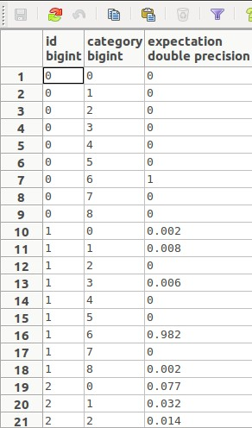
Step 10 Inference

Slide 20
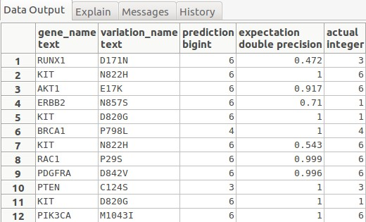
Step 11 Holdout Set Inference Result
Mention Error Rate:
3806 / 10876 = 34.99%
Match Proportion: 384 / 830 = 46.27%
Matched Error Rate: 170 / 384 = 44.27%

Slide 21
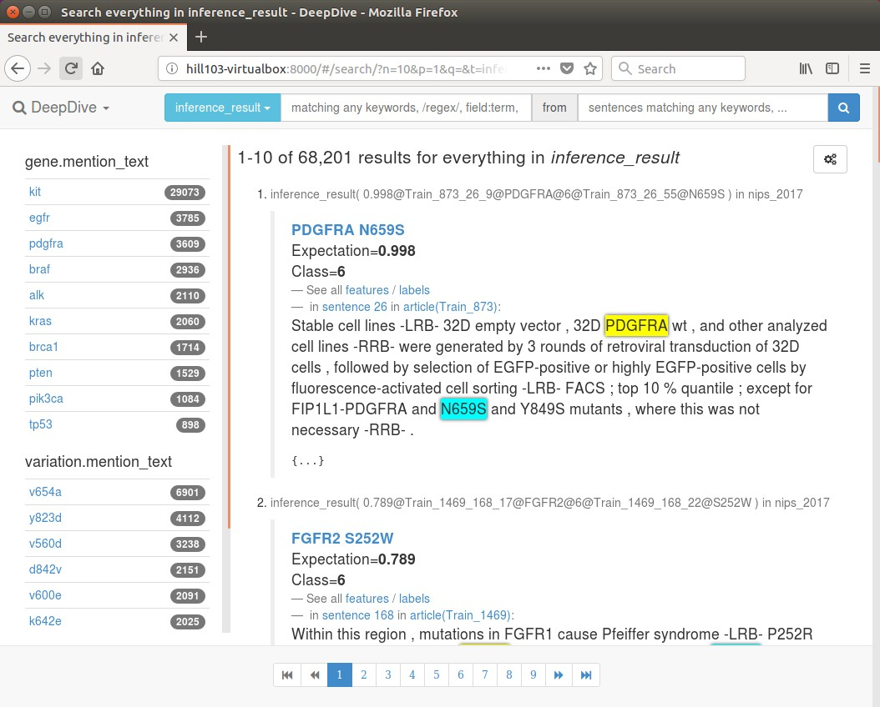
Visualization with mindbender

Slide 22
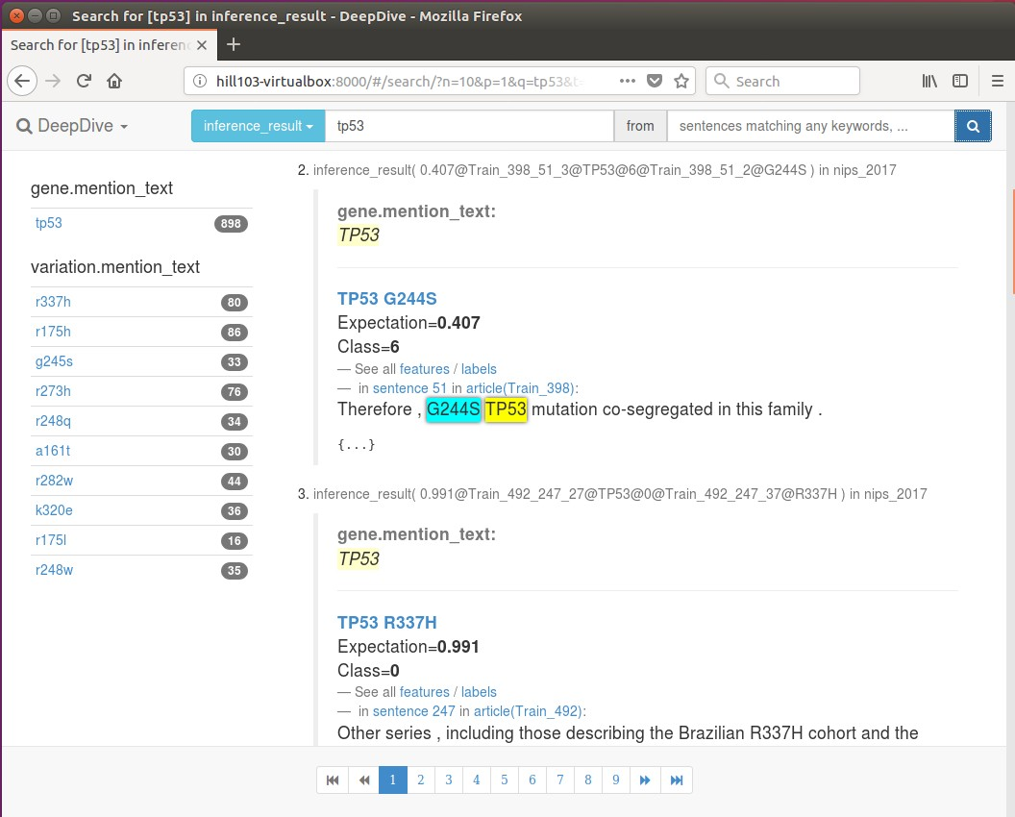
Search with mindbender: gene

Slide 23
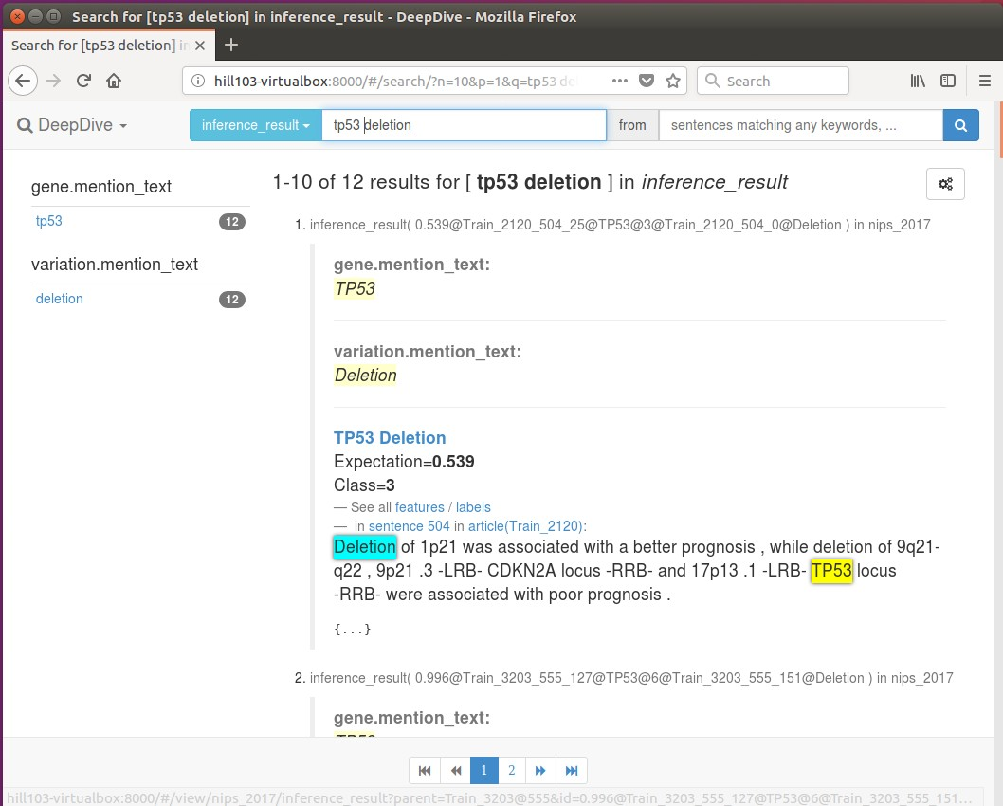
Search with mindbender: gene & variation

Slide 24
Summary
Using deepdive to solve a knowledge discovery problem: gene-variation-effect
Deepdive: a common tool
Integrating other tools: coreNLP, DDLib, DimmWitted, mindbender, mindtagger …
Flexibility: support user defined functions
Communication with PostgreSQL
Support binary and categorical relationship
Require programming skill: bash, python, SQL, HTML, DDlog
Stop updating from 2017

